Slide 1
Veterans Card – Victoria
Victoria thanks you for your service
Stakeholder pack

Slide 2
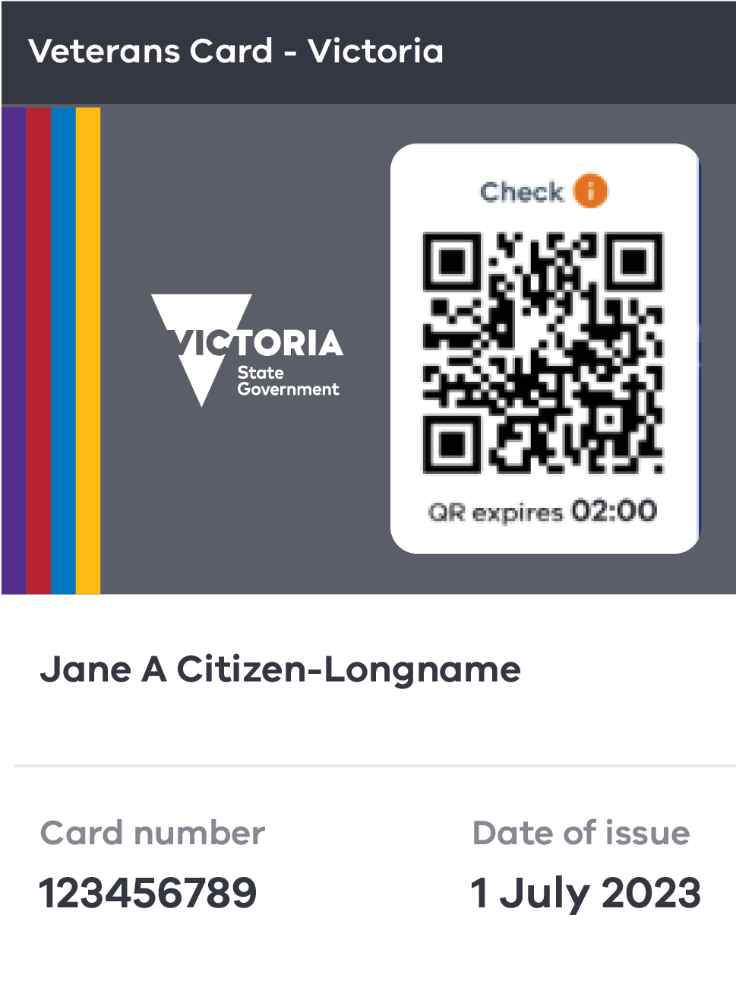
About the card
  The Veterans Card – Victoria offers:
$100 off light vehicle registration
One free trailer and one free caravan registration
Fishing licence exemption
Free boating (marine) licence
Free public transport on Anzac Day & Remembrance Day.
Access to veteran employment programs

Slide 3
Who is eligible and how to apply
  Who is eligible?
  Anyone who has served or is currently serving in the Australian Defence Force and resides in Victoria.
  The length, type or location of your service does not matter.
  How to apply
  Apply, store and show your card in the Service Victoria app on your smartphone or apply online at service.vic.gov.au

Slide 4
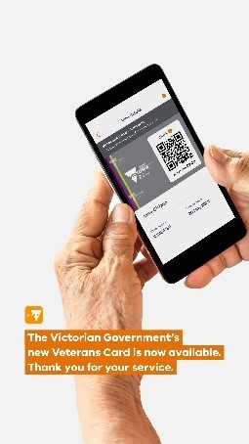
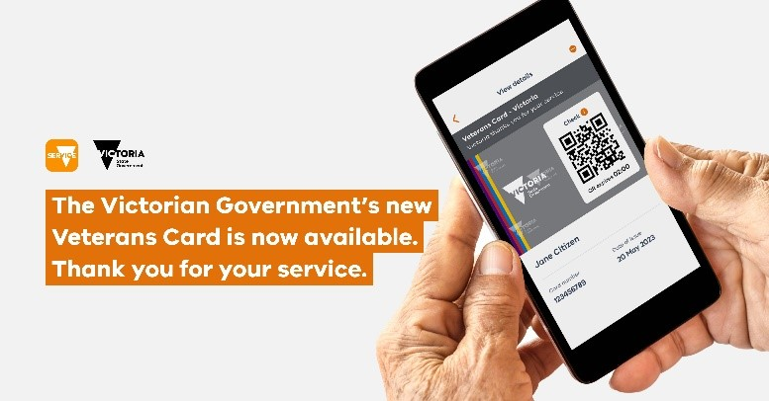
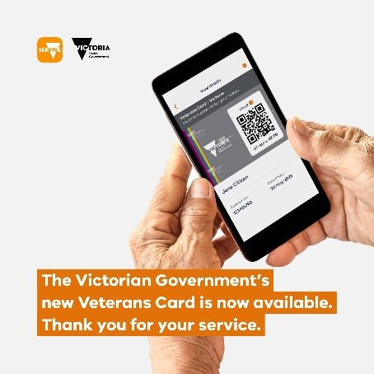
Social media assets
Download a full social media pack including suggested copy, hashtags and UTM links and images <https://www.vic.gov.au/sites/default/files/2023-07/Social-media_package.zip>.

Slide 5

Email signature banner
Download the email signature banner <https://www.vic.gov.au/sites/default/files/2023-07/Veterans-Card-Victoria-email-banner.png>
Download instructions for adding the banner to your email signature including
how to add a link and how to add alt text <https://www.vic.gov.au/sites/default/files/2023-07/Instructions-adding-email-signature-block.docx>

Slide 6
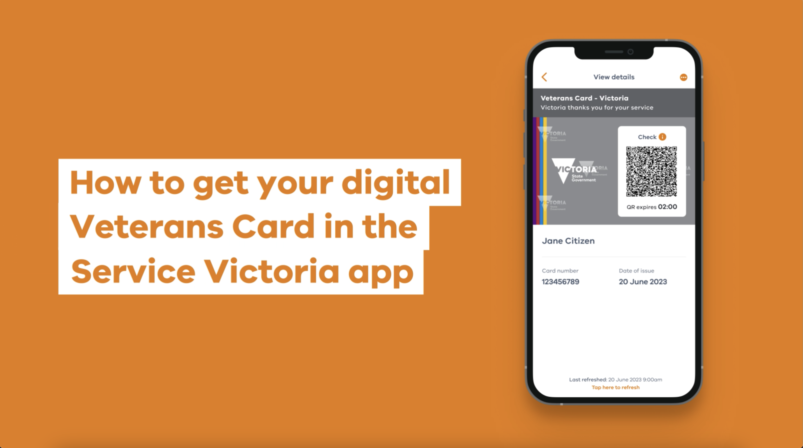
How to video
Available on YouTube <https://www.youtube.com/watch?v=DjKhMttm5nE>

Slide 7
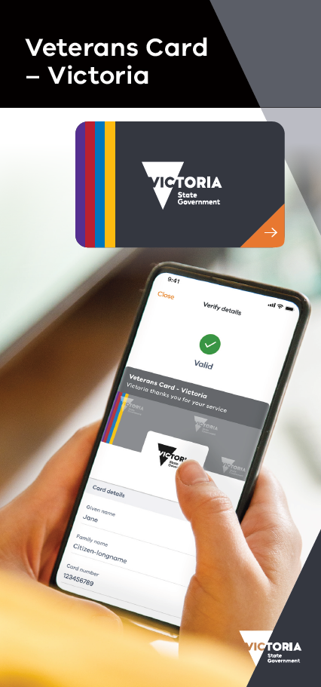
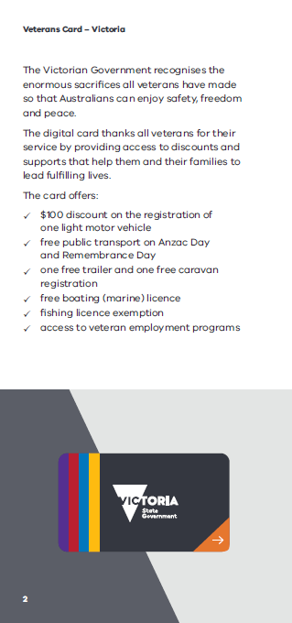
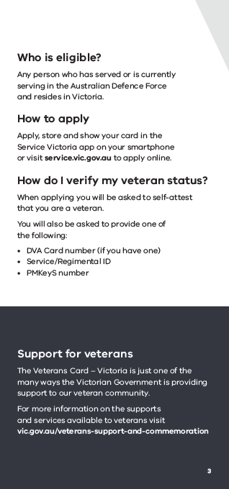
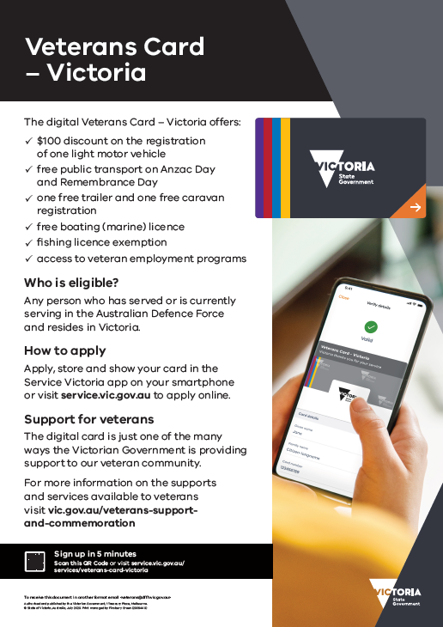
A2 poster & DL flyer
To request printed copies of these materials please fill out this form <https://forms.office.com/r/73H3PuYwWk>
Download an A4 print at home version of the poster here <https://www.vic.gov.au/sites/default/files/2023-07/Veterans-Card-Victoria_A4-Poster.pdf>
.

Slide 8
Newsletter copy
Headline: Discover the Veterans Card – Victoria, available now!
Body copy: The Victorian Government has introduced the digital Veterans Card, a program designed to express our gratitude and provide support to all veterans.
The digital Veterans Card is a token of appreciation, acknowledging the remarkable contributions and sacrifices made by veterans in ensuring the safety, freedom, and peace we enjoy today.
With the digital Veterans Card, veterans can access a range of exclusive benefits, including:
$100 discount on the registration of one vehicle
free public transport on Anzac Day and Remembrance Day
free trailer and caravan registration
free boating (marine) licence
fishing licence exemption
access to veteran employment programs.
To get a digital Veterans Card you’ll need a Service Victoria account and proof of your service such as a PMKeyS number, a Service/Regimental ID or a DVA Card number.
Apply, store and show your card in the Service Victoria app on your smartphone or apply online at service.vic.gov.au
Victoria thanks you for your service.

Slide 9
More information
Visit: www.service.vic.gov.au/services/veterans-card-victoria
Email: veterans@dffh.vic.gov.au
  To receive this presentation in another format email Office for Veterans <veterans@dffh.vic.gov.au>.
  Authorised and published by the Victorian Government, 1 Treasury Place, Melbourne.
  © State of Victoria, Australia, Department of Families, Fairness and Housing July 2023.
  Available at Concessions for veterans <https://www.vic.gov.au/concessions-veterans>.

