Slide 1
Grants Gateway
The Grants Gateway is an online platform used by people applying to the Department of Families, Fairness and Housing.
You can apply for the Premier’s Spirit of Anzac Prize 2024 using the Grants Gateway.
We recommend using Chrome or Microsoft Edge as your browser while accessing the Gateway.
The slides will assist you to create a new account or log in using existing details.

Slide 2
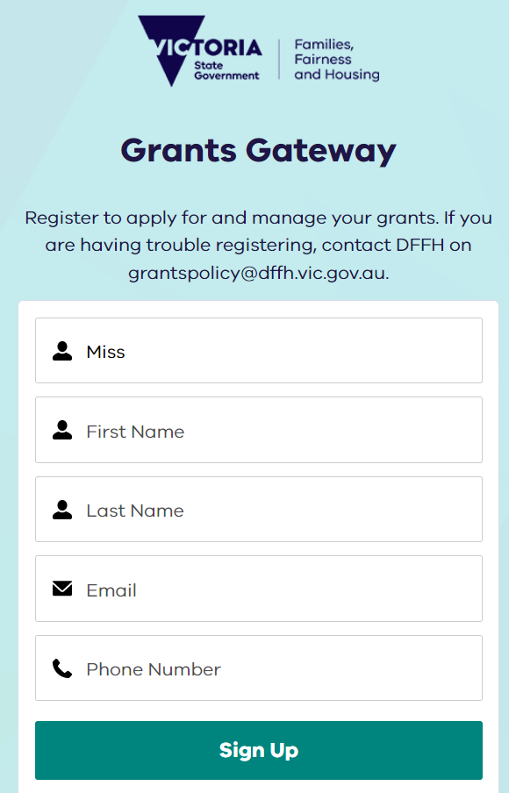
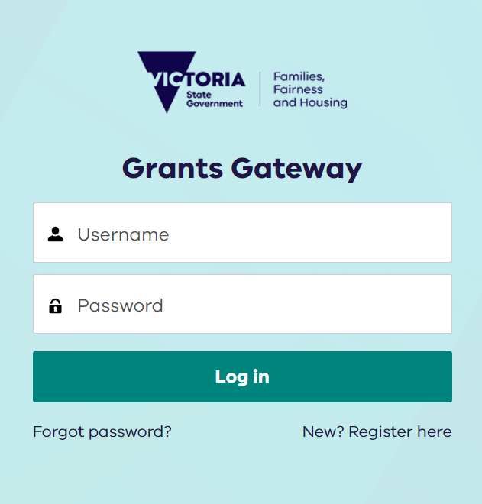
Grants Gateway – New users
Step 2.
Enter Title
X
Step 3.
Enter First Name
Step 1.
Click New? Register here
Step 4.
Enter Last Name
Step 5.
Enter Account Email
This will be your user login
Step 6.
Enter Preferred Contact Number
Step 7.
Click Sign Up

Slide 3
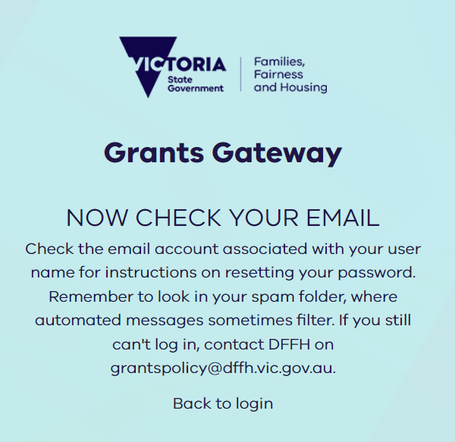
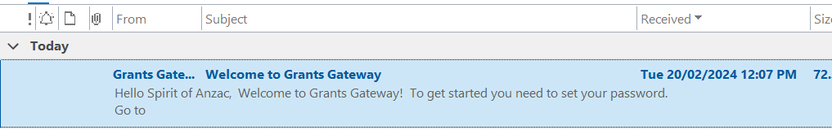
Grants Gateway – New users
X
Step 8.
Check for confirmation email for the register account
Step 9.
Open your email inbox and search for the subject line “Welcome to Grants Gateway” email from noreply@salesforce.com On Behalf Of Grants Gateway

Slide 4
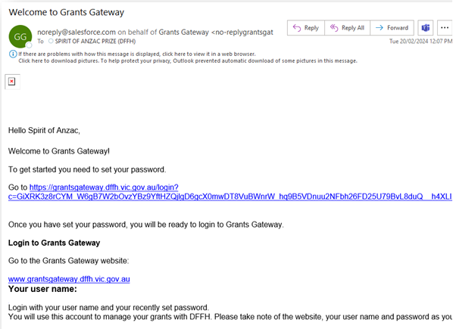
Grants Gateway – New users
X
Step 10.
Click on the link to confirm and register your account

Slide 5
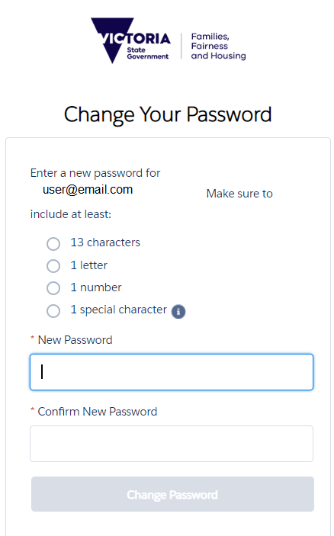
Grants Gateway – New users
Step 11.
After clicking on the email link you will be asked to create a password.
Password needs to contain:
13 characters (minimum) including
  1 Letter
  1 Number
  1 Special Character
X
Step 14.
You now have access to the Grants Gateway.
Step 12.
Confirm your password.
Step 13.
Click change password.

Slide 6
Grants Gateway – Existing / Returning user
Step 1.
Type your username/
email address
and password here and click “Log In”

Slide 7
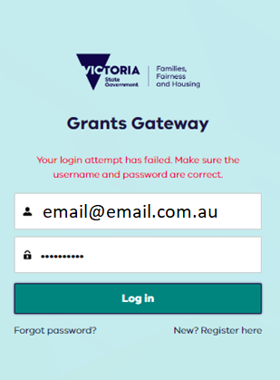
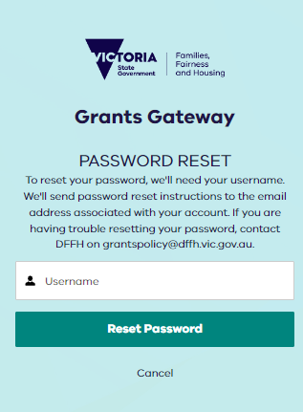
Grants Gateway – Existing User - Forgotten Password
Step 1.
If you have forgotten your password
click “Forgot Password”
Step 2.
Enter your username / email address and
click “Reset password”

Slide 8
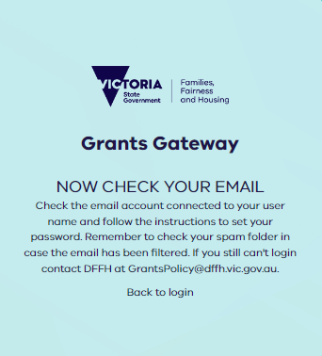
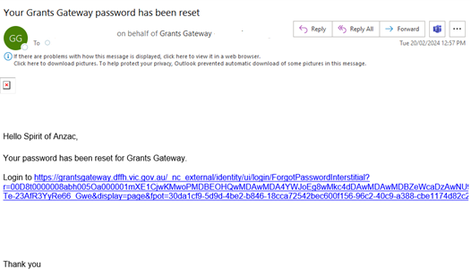
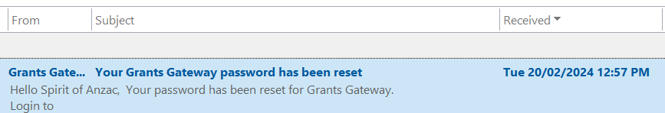
Grants Gateway – Existing User - Forgotten Password
Step 4.
Click on the link to Reset your password
Step 3.
Check and open grants gateway email

Slide 9
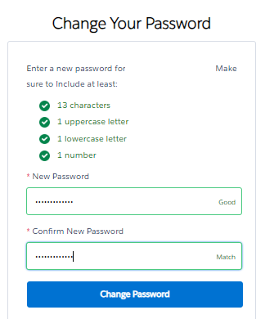
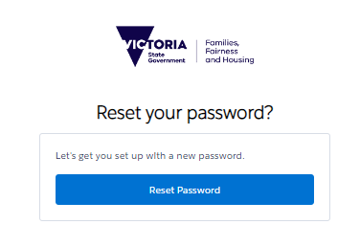
Grants Gateway – Existing User - Forgotten Password
Step 5.
click “Reset password”
Step 6.
After clicking on the link, you will be asked to create a new password.
Password needs to contain:
13 Characters (minimum) including
  1 Letter
  1 Number
  1 Special Character
Step 7.
Confirm your password by repeating it.
Step 8.
Click change password.

Slide 10
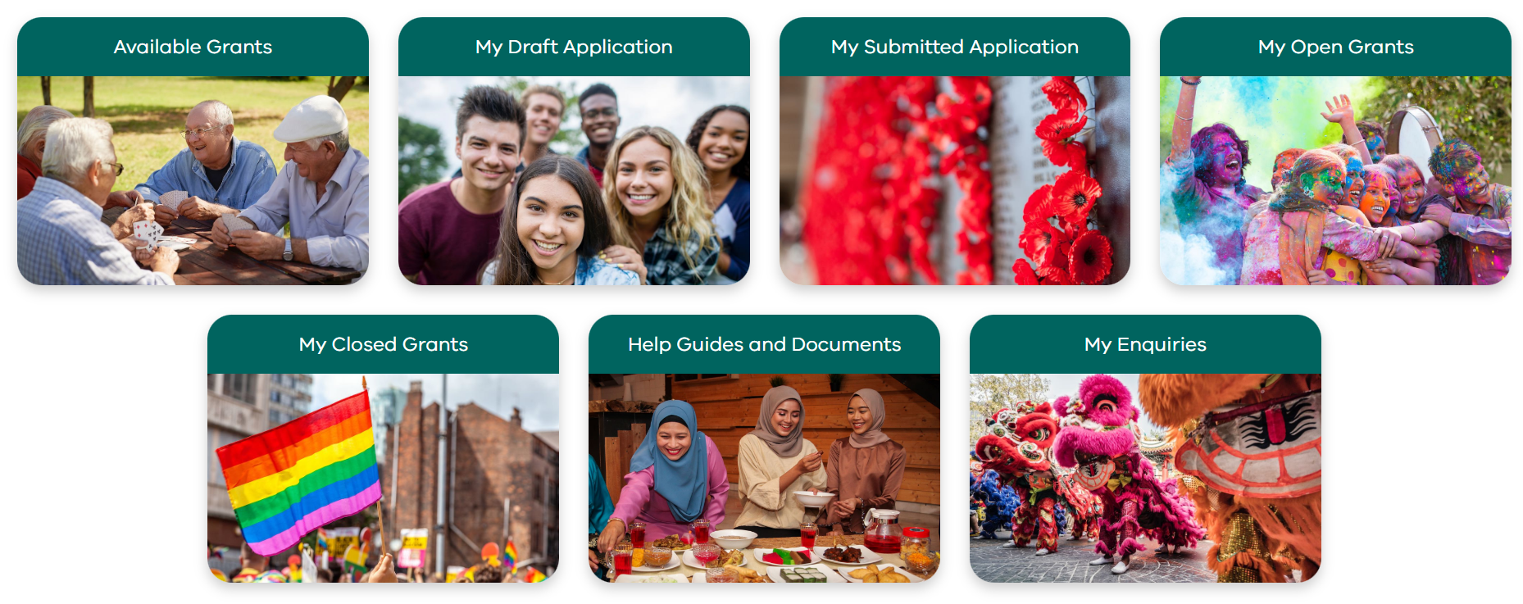
Grants Gateway – Navigation
My draft applications
If you have started an application, open it here.
Complete and submit your draft application.
If you have more than one draft application, please delete any that you do not need.
Submitted application
View your submitted application here, including attachments.
X
Available grants
Lists all grants available within Fairer Victoria.
Start a new application form here.
Help guides and documents
Resources to help you navigate the grants gateway.
My enquires
Contact us here. You can view your enquiry and our response here.

Slide 11
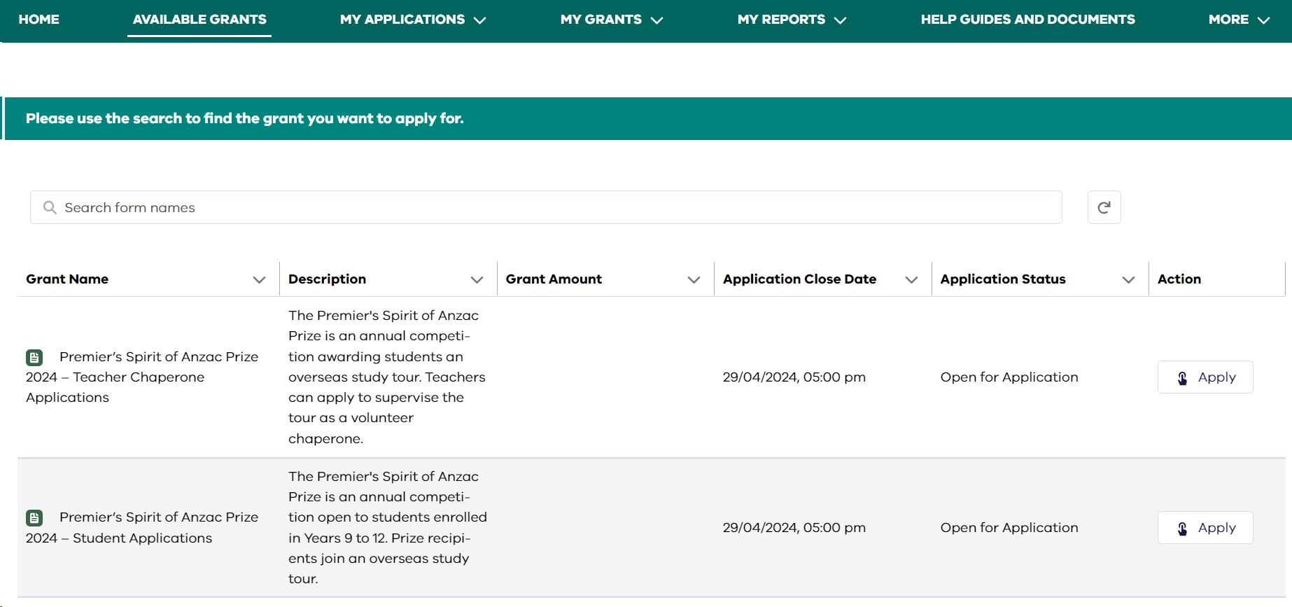
Start your application

